Slide 1
CMOS Technology
CMOS: Complementary metal–oxide–semiconductor.
Also known as complementary-symmetry metal–oxide–semiconductor.
It is a type of MOSFET fabrication process that uses complementary and symmetrical pairs of p-type and n-type MOSFETs for logic functions.
The transistors are arranged in a structure formed by two complementary networks .
Pull-up network is complement of pull-down network.

Slide 2

Characteristics of CMOS Technology
Lower static power dissipation
Higher noise margins and packing density
High yield with large integrated complex functions
High input impedance and scalable threshold voltage
High delay load sensitivity
Low transconductance, where transconductance, g_{m}
Bi-directional capability (drain & source are inter changeable)
A near ideal switching device
Low gain

Slide 3
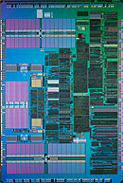
IC
An Integrated Circuit is an electronic network fabricated in a single piece of a semiconductor material
The semiconductor surface is subjected to various processing steps in which impurities and other materials are added with specific geometrical patterns
The fabrication steps are sequenced to form three dimensional regions that act as transistors and interconnects that form the switching or amplification network

Slide 4
Lithography
It is a process that is used to transfer patterns to each layer of the IC
Lithography sequence steps:
Designer:
Drawing the layer patterns on a layout editor
Silicon Foundry:
Masks generation from the layer patterns in the design data base
Printing: transfer the mask pattern to the wafer surface
Process the wafer to physically pattern each layer of the IC

Slide 5
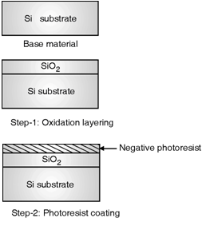
Lithography Sequence Steps
Step 1 : Oxidation layering
A thin layer of SiO₂ is deposited over the complete wafer by exposing it to oxygen.
Step 2 : Photoresist coating
A light sensitive polymer is coated on the wafer.
This material is soluble in organic solvent but has the property that when exposed to light, the light exposed regions become insoluble in organic solvent this types of photoresist is called as negative photoresist.

Slide 6
Lithography Sequence Steps
Step 3 : Stepper exposure
A reticle or (a mask) which contains patterned layout is brought close proximity to the wafer.
The mask is transparent in some regions and opaque in the regions which we wanted to process.
The combination of mask and wafer is now exposed to ultraviolet light.
If the negative photoresist is coated on the wafer then the region where the mask is transparent, the photoresist becomes insoluble.

Slide 7
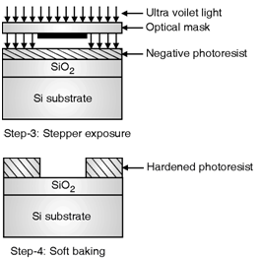
Lithography Sequence Steps
Step 4 : Soft baking
The wafers are kept in either on acidic or basic solutions to remove the non exposed areas of photoresist.
Once the exposed photoresist is removed the wafer soft baking at a low temperature to harden the remaining photoresist.
Step 5 : Acid etching
The material from the selected areas which are not covered with photoresist is removed by using different types of acid base and acoustic solutions.

Slide 8
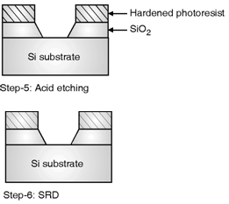
Lithography Sequence Steps
Step 6 : SRD
This is called as Spin, Rinse and Dry step which cleans the wafer with deionized water and dries it with Nitrogen.
Step 7 : Various process steps
the exposed area can be used for other processing steps such as ion implantation, plasma etching or metal deposition.

Slide 9
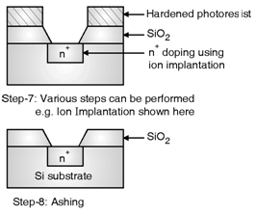
Lithography Sequence Steps
Step 8 : Ashing
This step is used to remove the remaining photoresist without damaging the other wafer areas where devices are formed.
As this photoresist was exposed to light this is hard and insoluble in solvent hence to remove this, high temperature plasma is used.

Slide 10
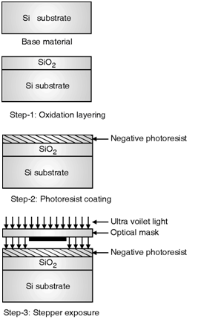
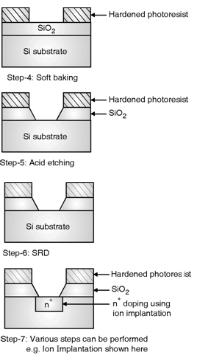
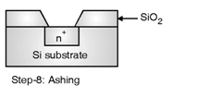
Lithography Sequence Steps (All)

Slide 11
Physical structure of PMOS
PMOS physical structure:
p-substrate
n-well (bulk)
p+ source/drain
gate oxide (SiO₂)
polysilicon gate
CVD oxide
metal 1
PMOS layout representation:
Implicit layers:
oxide layers
Drawn layers:
n-well (bulk)
n+ regions
polysilicon gate
oxide contact cuts
metal layers
Notes:
Chemical Vapour Deposition Oxide = CVD Oxide

Slide 12
Physical structure of NMOS
NMOS physical structure:
p-substrate
n+ source/drain
gate oxide (SiO2)
polysilicon gate
CVD oxide
metal 1
L_{eff}<L_{drawn} (lateral doping effects)
NMOS layout representation:
Implicit layers:
oxide layers
substrate (bulk)
Drawn layers:
n+ regions
polysilicon gate
oxide contact cuts
metal layers

Slide 13
Etching
Etching is the process of material being removed from a material’s surface.
Etching is a critically important process module, and every wafer undergoes many etching steps before it is complete.
Etching techniques:
The two major types of etching are
i) wet etching ii) dry etching or plasma etching.
The etching process that involves using liquid chemicals or etchants to take off the substrate material is called wet etching.
In the plasma etching process, also known as dry etching, plasmas or etchant gases are used to remove the substrate material.

Slide 14
Etching
 | Wet Etching | Dry Etching
Method | Chemical Solutions | Chemical or physical Reactive
Environment and equipment | Atmosphere, Bath | Vacuum Chamber
Advantage | Low cost, easy to implement High etching rate Good selectivity for most materials | High resolution and cleanliness. Better process control. Ease of automation
Disadvantage | Inadequate for defining feature size < 1um Potential of chemical handling hazards Wafer contamination issues | High cost, hard to implement Low throughput Poor selectivity Potential radiation damage
Directionality | Isotropic (Except for etching Crystalline Materials) | Anisotropic

Slide 15
Yield
Yield means number of good chips produced from a dice
The yield is influenced by:
the technology
the chip area
the layout
Yield can be approximated by:
A - chip area (cm²)
D - defect density (defects/cm²)
8-Aug-21
15

Slide 16
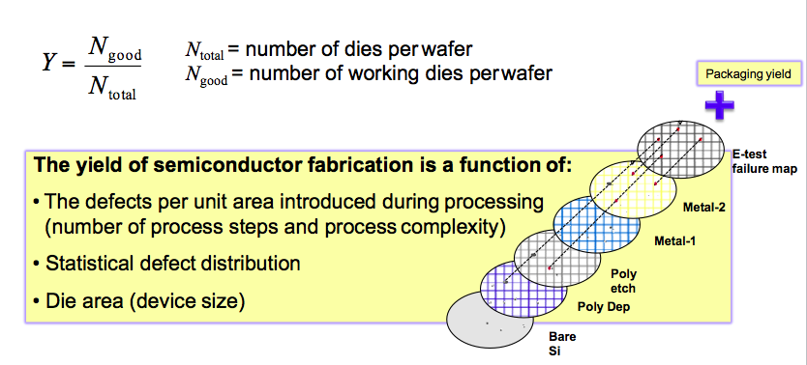
Yield

Slide 17
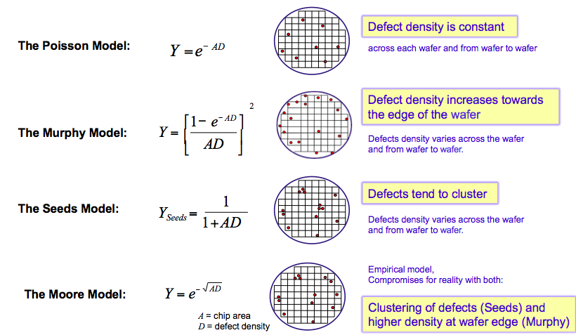
Models of Yield

Slide 18

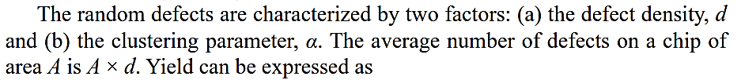

Yield Vs Company Profitability
Yield of a process determines the profitability of a semiconductor company.
Yield can be written as

Slide 19
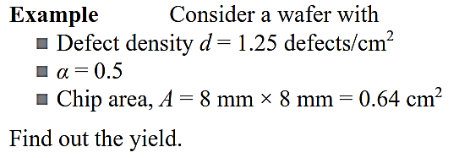
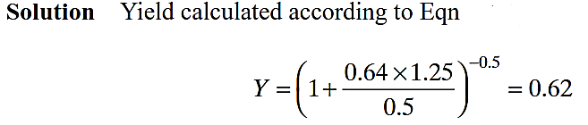
Math -1

Slide 20
Math-2
Consider a wafer with
Defect density d = 1.25 defects/cm²
clustering parameter α = 0.5 and Chip area, A = 8 mm × 8 mm = 0.64 cm²
each wafer has 500 chips
The cost of processing a wafer is $100
Calculate the processing cost per chip.
Calculate the processing cost per chip if Design for testability (DFT) is included, which increases the chip area by 10%

Slide 21
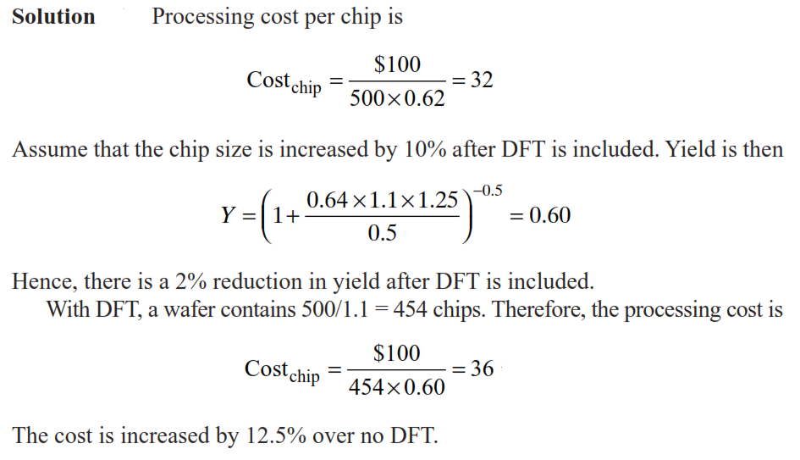
Math

Slide 22
Other Processes- SOI
Silicon On Insulator (SOI)
Silicon on insulator (SOI) technology refers to the use of a layered silicon–insulator–silicon substrate in place of conventional silicon in semiconductor Manufacturing.
Developed by IBM
8-Aug-21
22

Slide 23
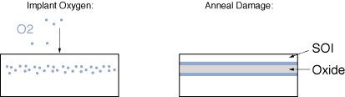
Other Processes - SOI
SOI wafers can also be manufactured by a method called: Separation by Implantation of Oxygen (SIMOX)
The starting material is a silicon wafer where heavy doses of oxygen are implanted
The wafer is annealed until a thin layer of SOI film is formed
Once the SOI film is made, the fabrication steps are similar to those of a bulk CMOS process
8-Aug-21
23

Slide 24
Other Processes -SOI
Silicon On Insulator (SOI)
Advantages:
No wells ⇒ denser transistor structures
Lower substrate capacitances
Very low leakage currents
No FOX FET exists between unrelated devices
No latchup
No body-effect:
However, the absence of a backside substrate can give origin to the “kink effect”
Radiation tolerance
Disadvantages:
Absence of substrate diodes (hard to implement protection circuits)
Higher number of substrate defects ⇒ lower gain devices
More expensive processing
8-Aug-21

